Slide 1
Online Patient Management System
Azizul Islam Nayem(011201262) All Tables:
………………..
Doctor
Qualifications
Pa
Patient
Diseases
Test
All Queries: INSERT
.................
INSERT INTO doctor VALUES ( NULL, '$fn', '$mn','$ln','$age','$dn','$de','$jd'); INSERT INTO qualifications VALUES ('$dql','$dd','$di',NULL,'$did');
INSERT INTO pa VALUES ($sa, '$ep','$sn','$en','$pn','$st','$zc','$c',NULL,$doi);
INSERT INTO patient VALUES ( NULL,'$e', '$dob','$fn','$mn','$ln','$pn','$st','$c','$zc','$sta',$did); INSERT INTO diseases VALUES ('$din', NULL,'$ds',$docid);
INSERT INTO test VALUES ( '$tn', '$r','$tin',NULL,$pid,$did);
SELECT
..........................
SELECT * FROM doctor;
SELECT * FROM qualifications; SELECT * FROM pa;
SELECT * FROM patient; SELECT * FROM diseases; SELECT * FROM test;

Slide 2
DELETE
...................
DELETE FROM doctor WHERE Doctor_id=$Doctor_id; DELETE FROM qualifications WHERE Qua_ID=$Qua_ID; DELETE FROM pa WHERE PA_ID=$PA_ID;
DELETE FROM patient WHERE Patient_id=$Patient_id;
DELETE FROM diseases WHERE Diseases_Code=$Diseases_Code; DELETE FROM test WHERE Test_Serial=$Test_Serial;
UPDATE
...............
UPDATE doctor SET First_Name='$fname', Middle_Name='$mname', Last_Name='$lname', Age='$age', Doctor_Number='$dno' , Doctor_Email='$dem' , Joining_Date='$jdate' WHERE Doctor_id = $id;
UPDATE qualifications SET Doc_Q_length='$dol', Doc_Degree='$dd', Doc_Institution='$di', Doctor_id='$did' WHERE Qua_ID = $id;
UPDATE pa SET Salary='$s', Email_PA='$ep', Start_Name='$sn', End_Name='$en', PA_Number='$pn' , Street='$st' , Zip_Code='$zp', City='$c', Doctor_id='$did' WHERE PA_ID = $id;
UPDATE patient SET Email='$e', DOB='$dob', First_Name='$fn', Middle_Name='$mn', Last_Name='$lm' , Patient_Number='$pn' , Street='$st',City='$c', Zip_Code='$zc', State='$sta' , Doctor_id='$did' WHERE Patient_id = $id;
UPDATE diseases SET Diseases_Name='$dn', Diseases_Symptom='$ds', Doctor_id='$did' WHERE Diseases_Code = $id;
UPDATE test SET Test_Name='$tn', Result='$r', Time_Needed='$tin', Patient_id='$pid', Doctor_id='$did' WHERE Test_Serial = $id;

Slide 3
AGRREGATIONS
................
SELECT COUNT(*) c FROM doctor;
SELECT Max(salary) c,Sum(salary) s FROM pa;
JOIN
..................
SELECT d.Doctor_Email,q.Doc_Institution FROM doctor d JOIN qualifications q USING(Doctor_id);
SELECT d.First_Name,d.Middle_Name,d.Last_Name, di.Diseases_Name FROM doctor d JOIN diseases di USING(Doctor_id);
SUB
................
SELECT Start_Name,End_Name,Salary from pa WHERE Salary=(SELECT max(Salary) from pa);
SELECT First_Name,Middle_Name,Last_Name from patient WHERE Zip_Code IN(SELECT Zip_Code FROM patient WHERE City = 'Dhaka');
Pages:

Slide 4
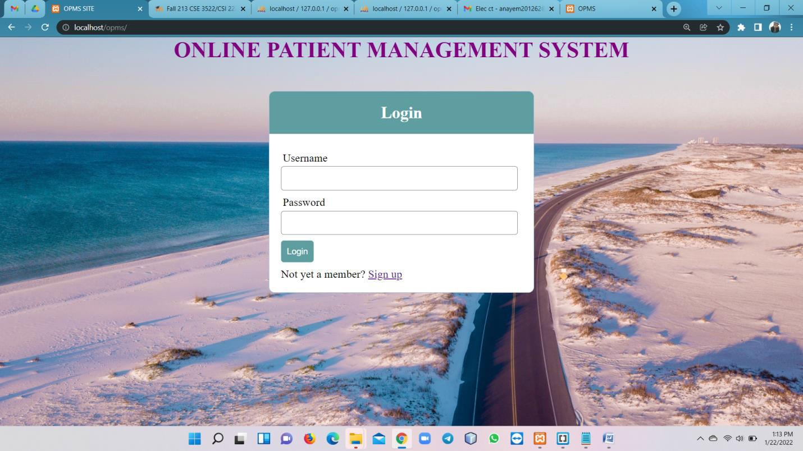
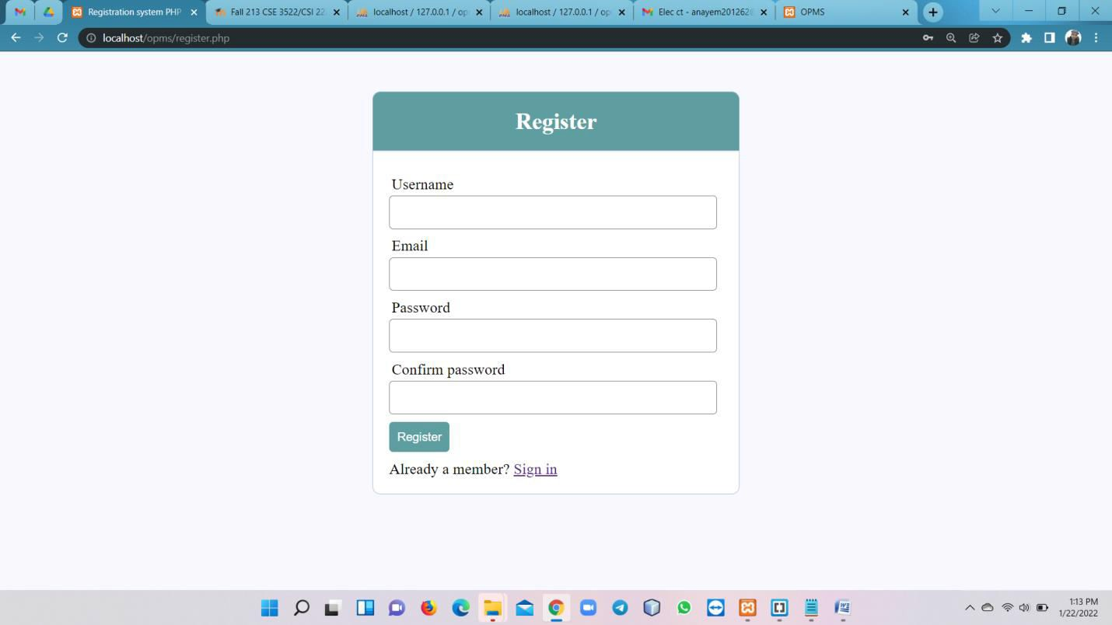

Slide 5
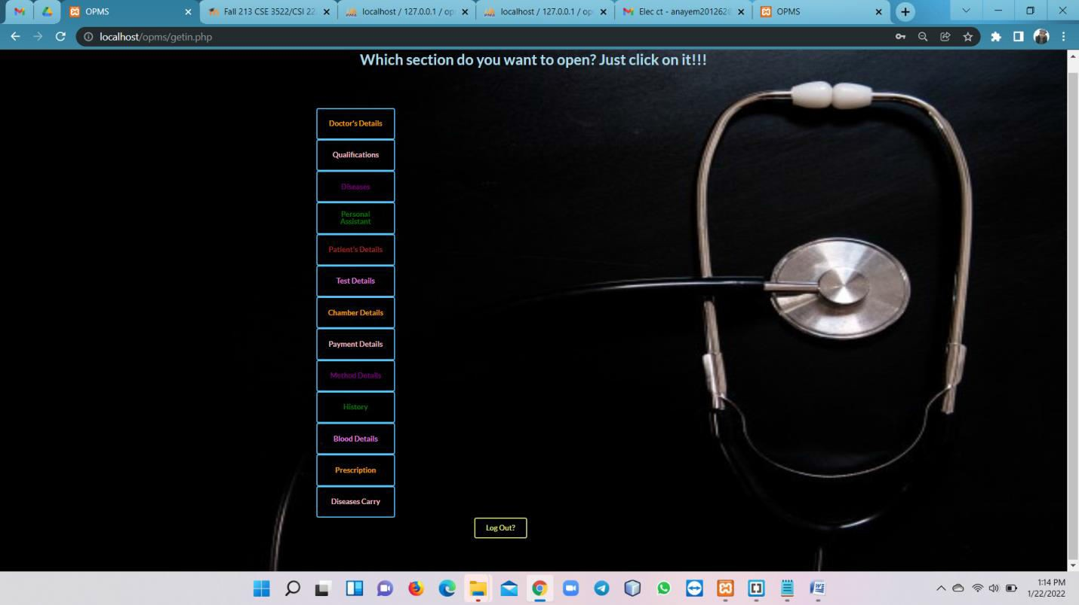
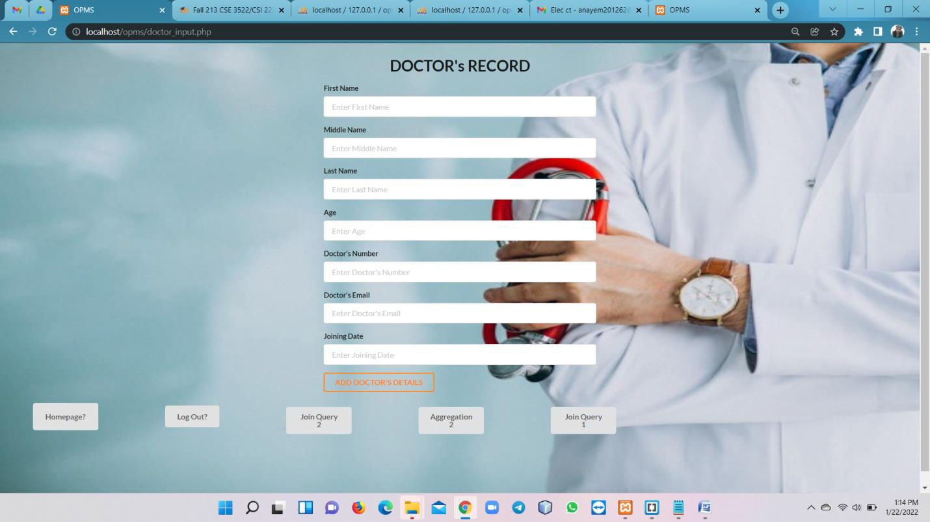

Slide 6
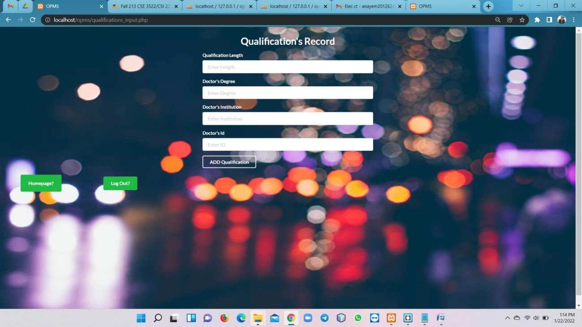
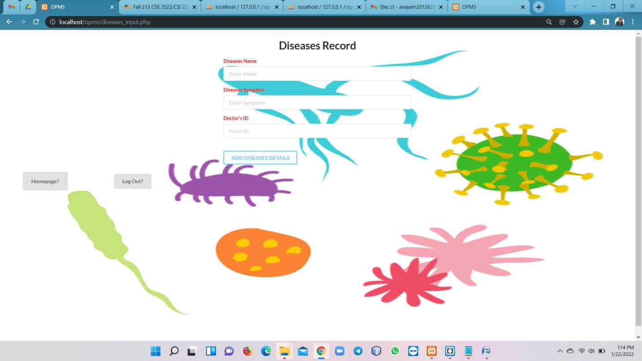

Slide 7
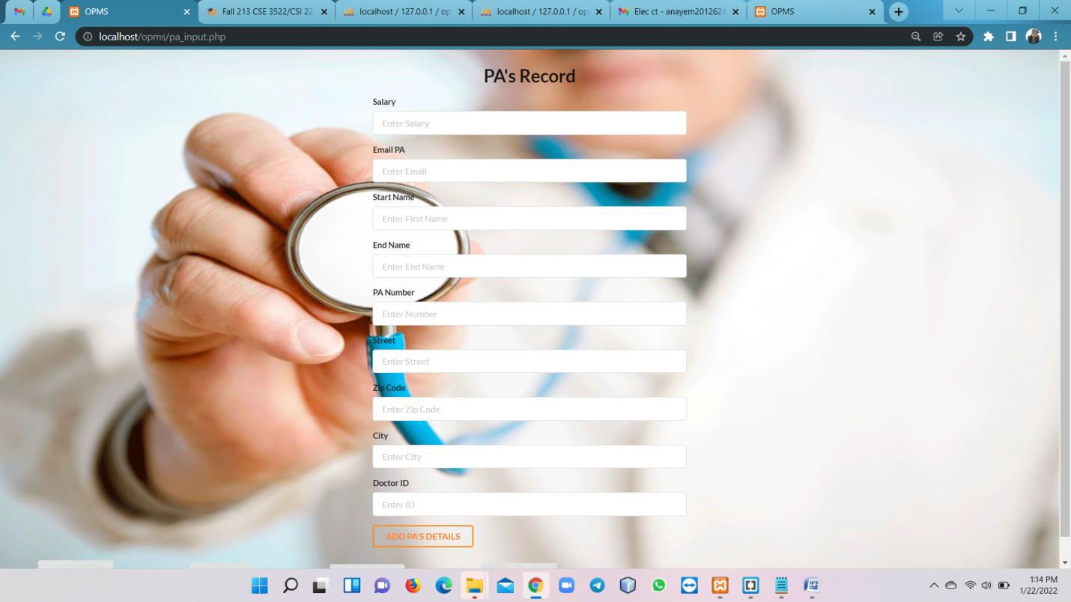
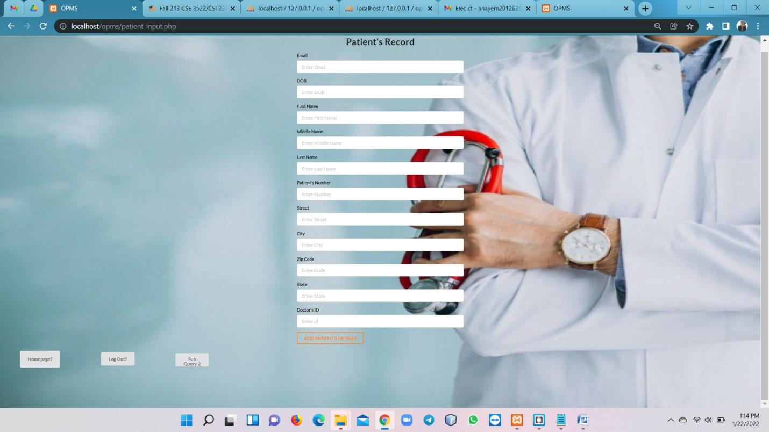

Slide 8
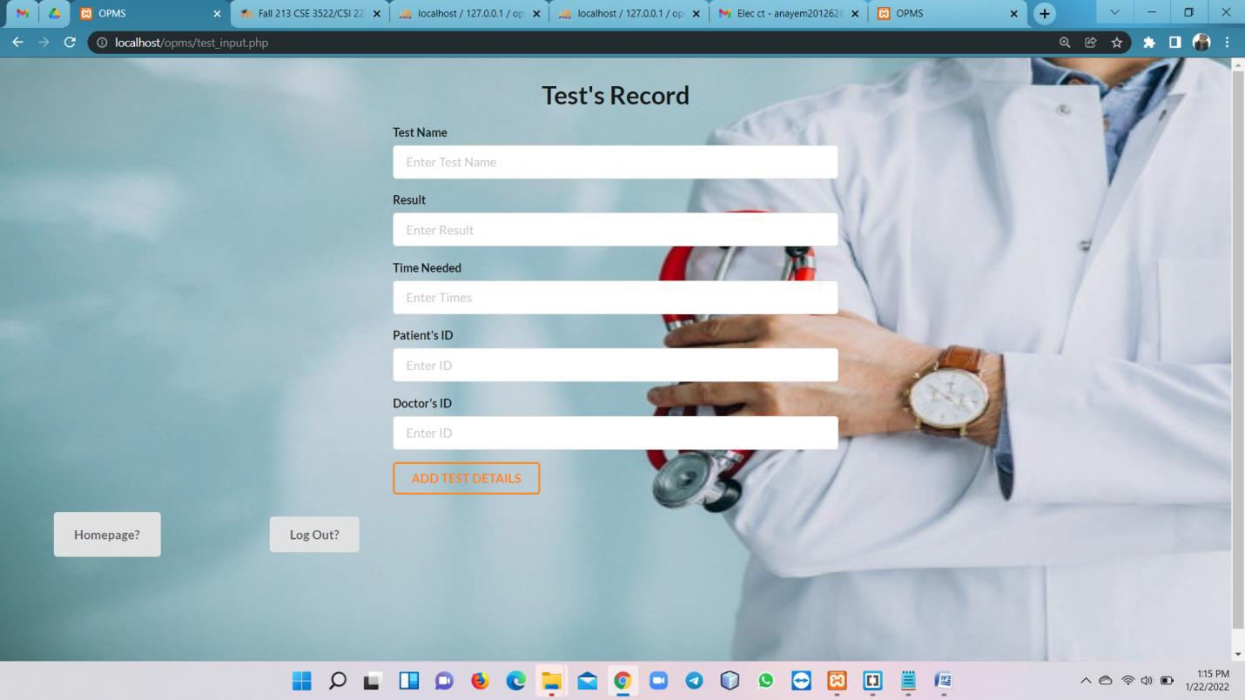
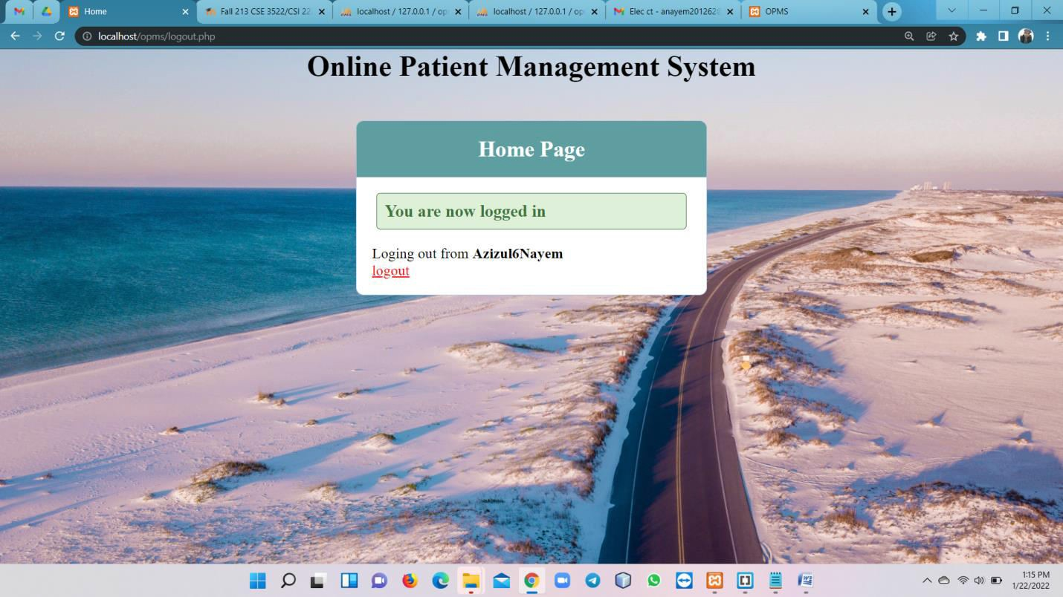

Slide 9
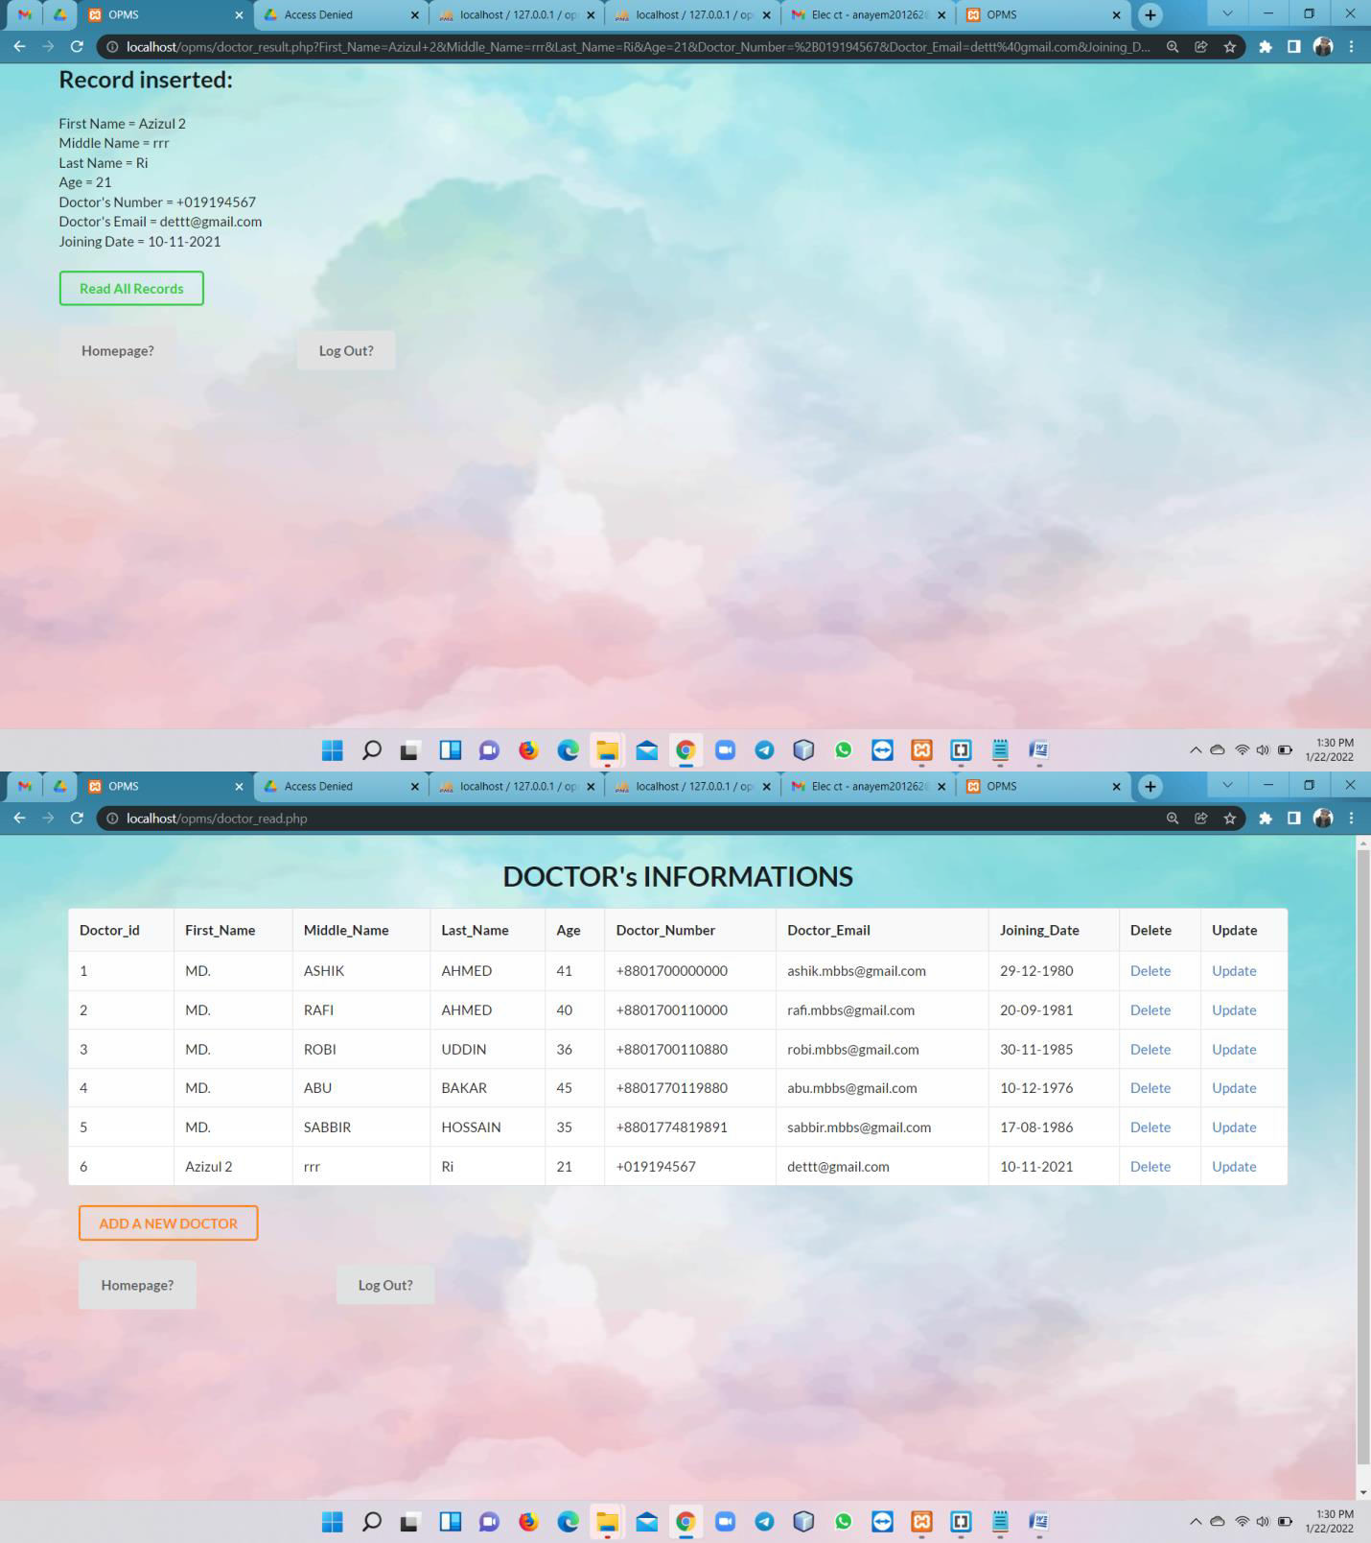

Slide 10
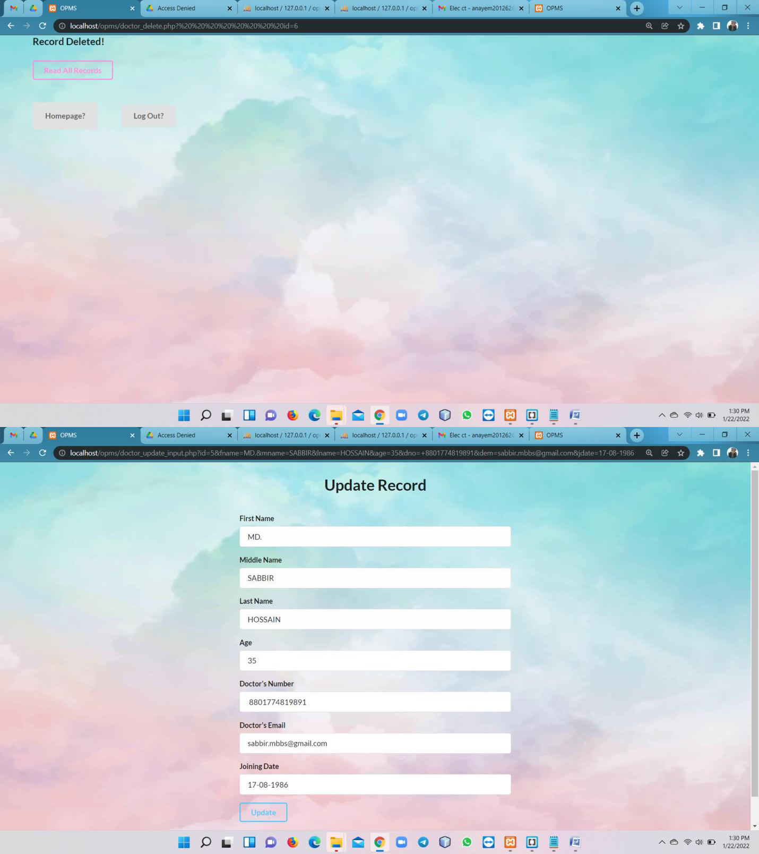

Slide 11
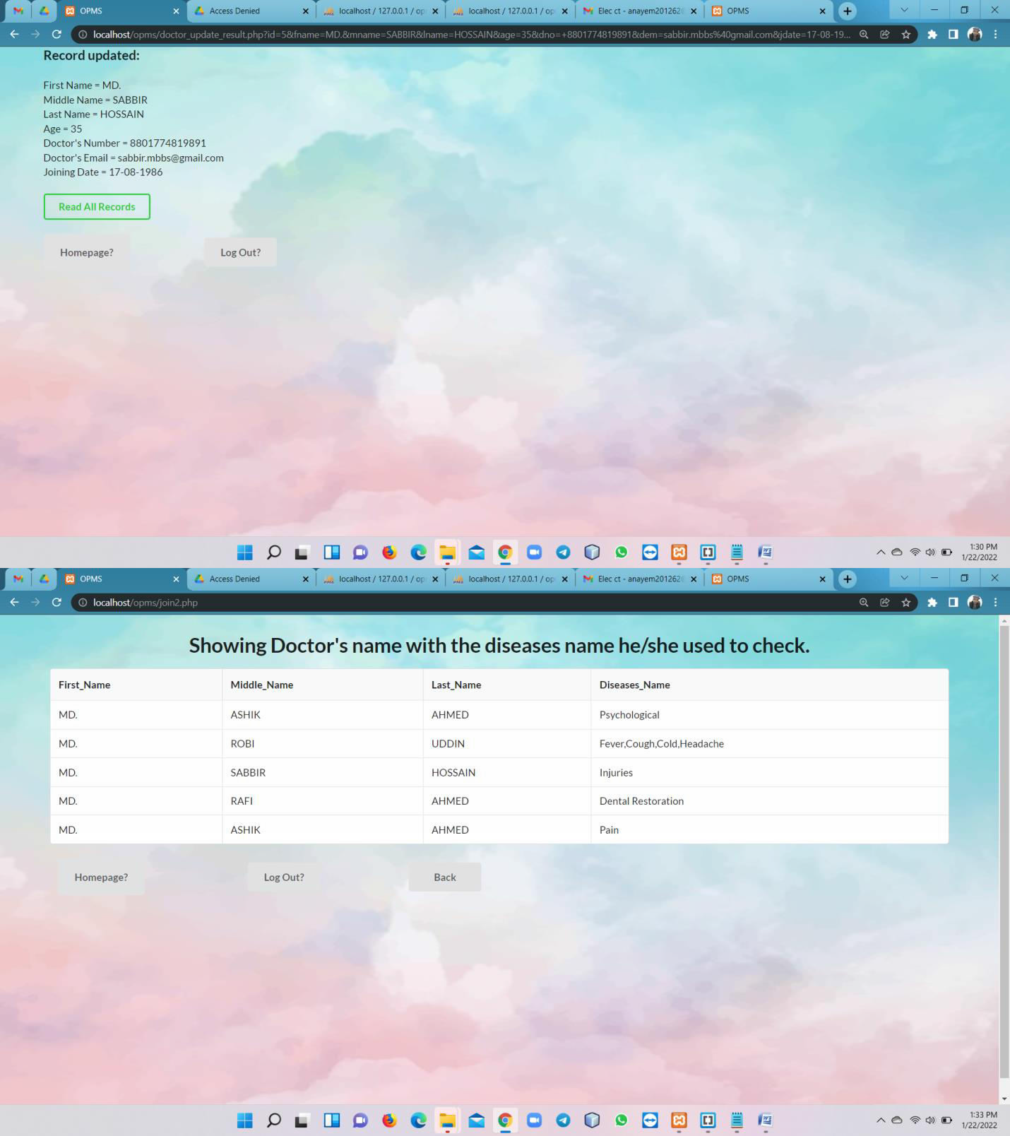

Slide 12
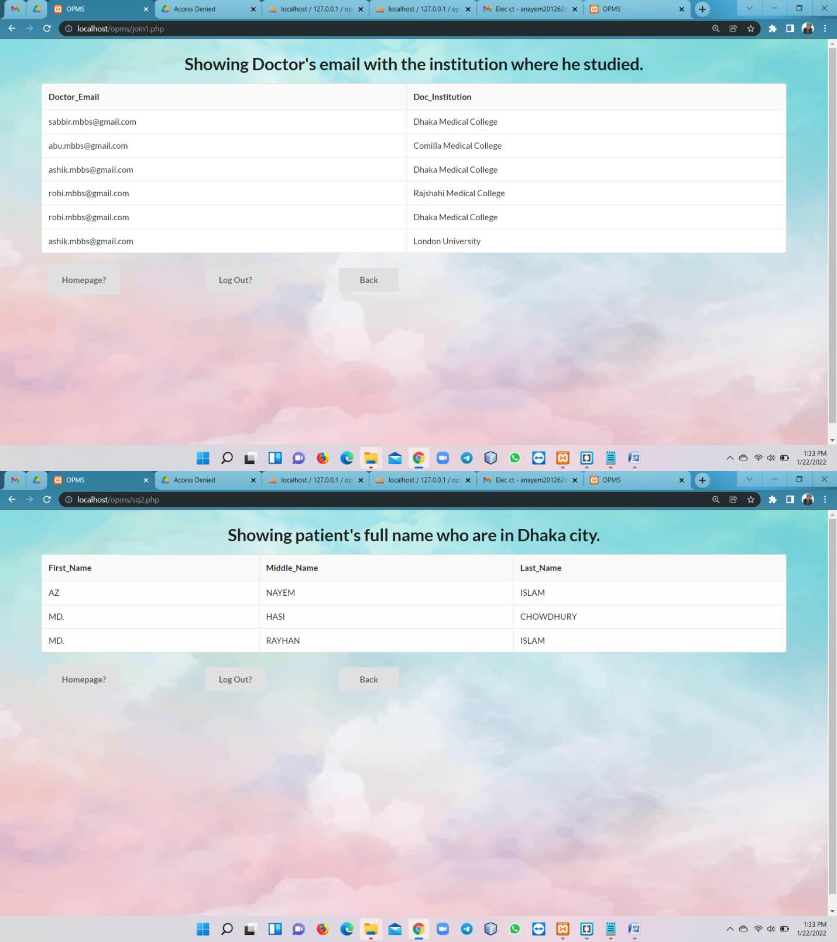

Slide 13
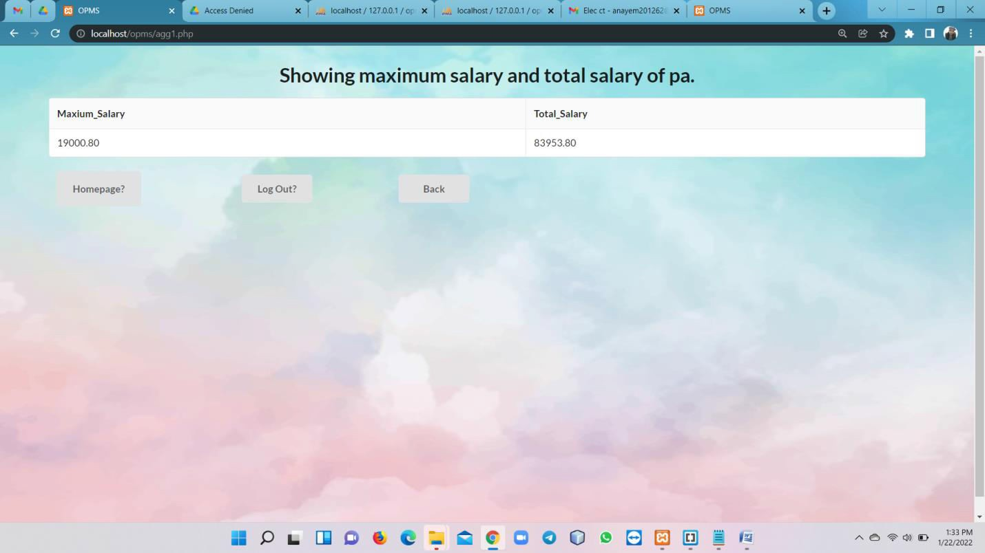
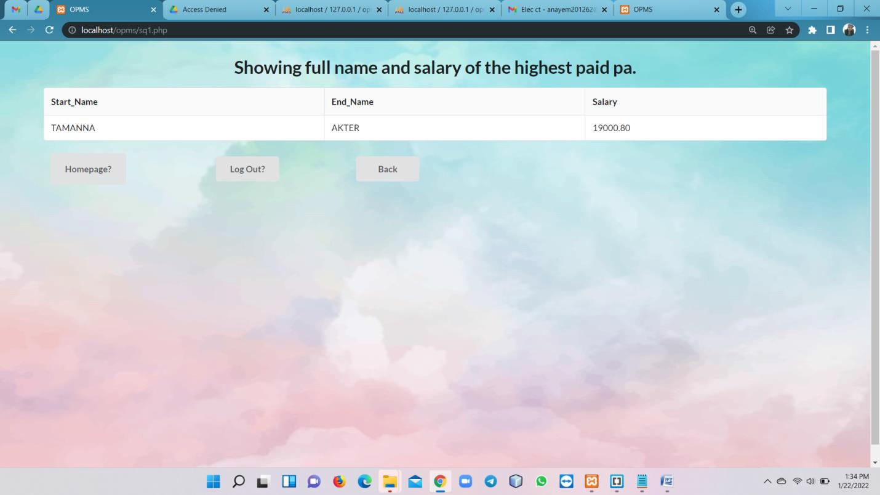

Slide 14
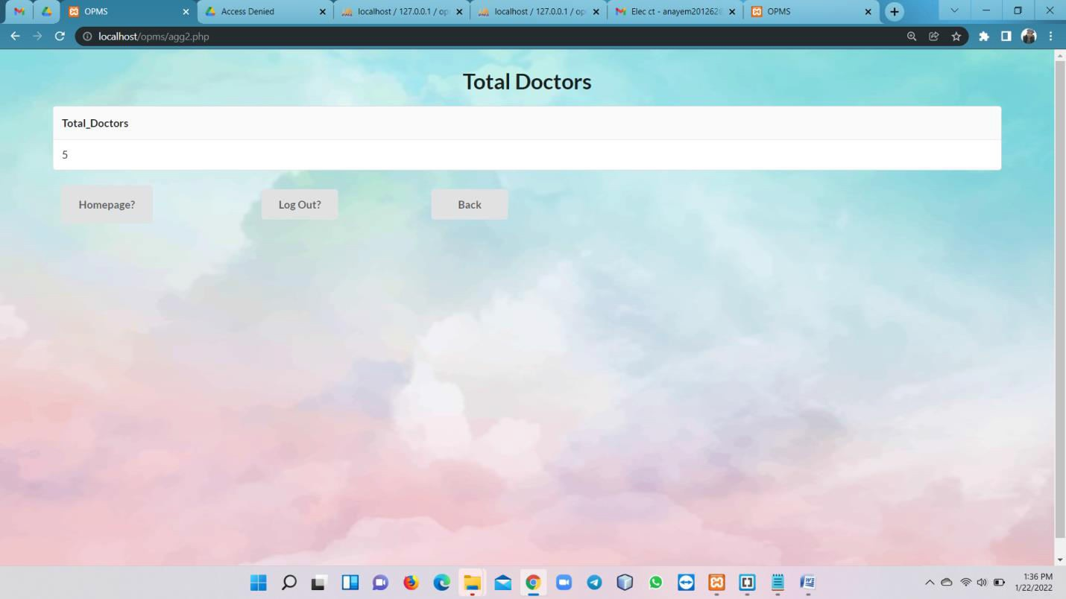
Features:
Mobile Compatibility (unstackable).
Accessible to All Users (doctor, pa, patient).
Well Planned Information.
Easy to log in, sign up and log out.
Easy to delete, add, update, read any information.
Fast Access.
Well implementation of all queries (especially advance queries).
Pages Consistency.
Designed Buttons.
Attractive Backgrounds.
Good Error Handling.

